Slide 1
Explore The World
Presented By:
Sai Krishna Bandaru, Ajith Kallur, Pavan Kumar Bodineni
Syracuse University College of Engineering and Computer Science
May 11, 2016

Slide 2

What is it?
A platform that enables people to get the most out of the places they visit, with help of locals who create experiences for our users. Experiences are personalize and curated in order to give our users a unique view of the places they visit

Slide 3
Why this app?
One Tap, to new travel experiences
No Need to Plan your activities while in a new city
Meet new people and make friends
A unique view of the places you visit

Slide 4
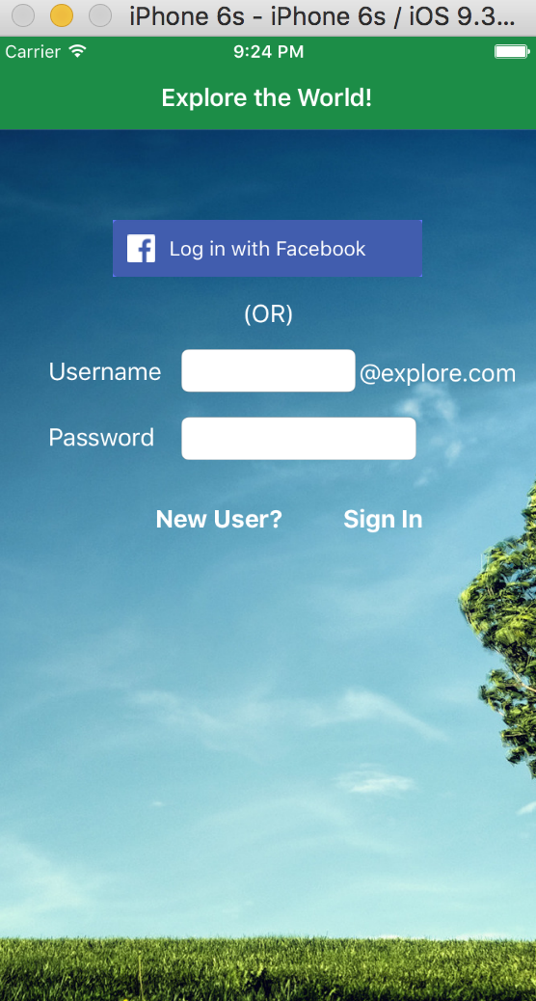
Login Screen
Using Facebook api for login

Slide 5
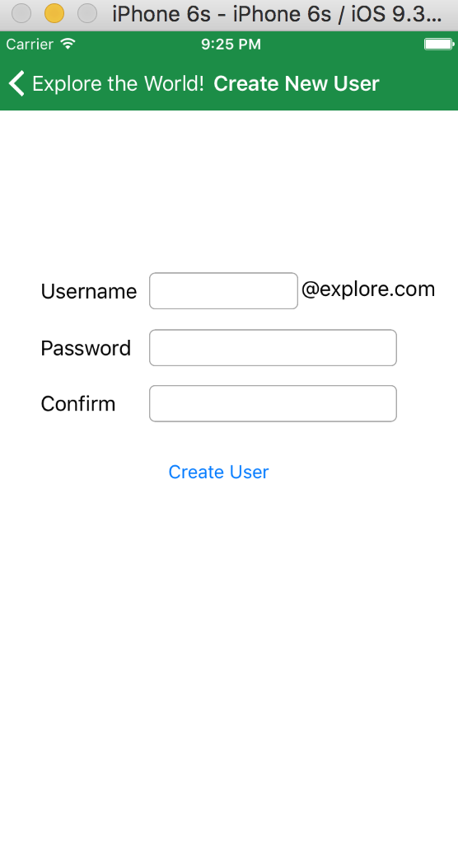
Custom login
Using Firebase api for custom login

Slide 6
Home Screen
Populate Table View taking current location by default
Use Yelp api to get locations data
CLLocation Manager to get current location
Tabbed View controller

Slide 7
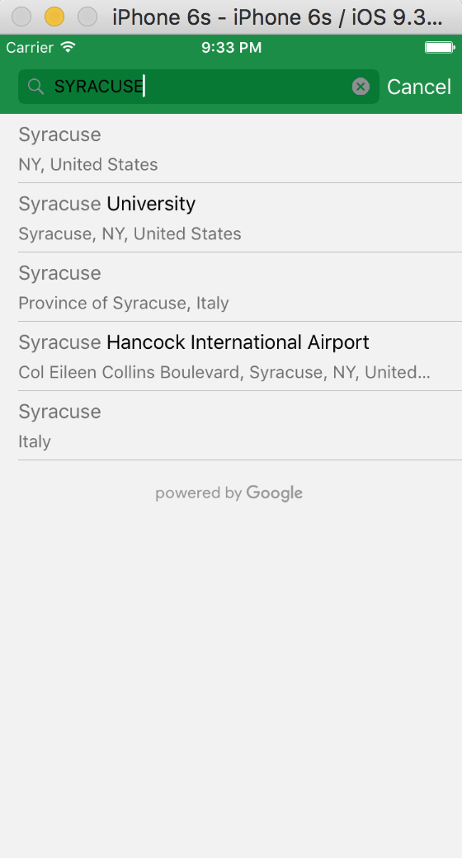
Auto Complete
Google places api

Slide 8
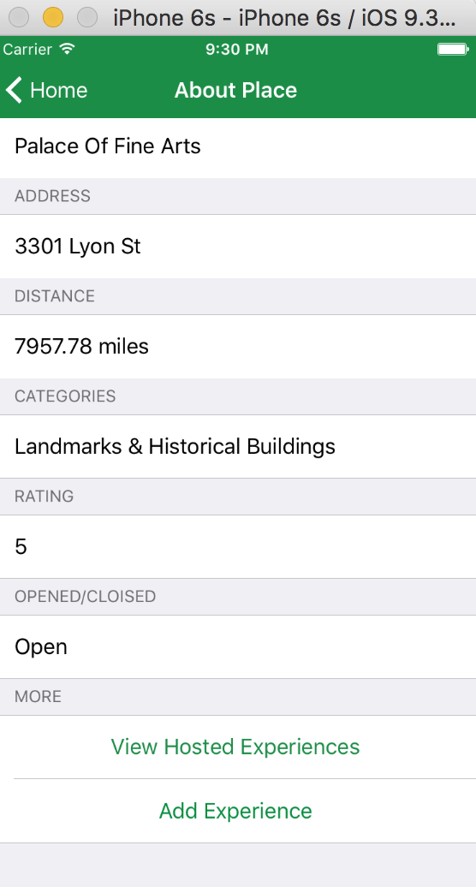
Location details

Slide 9
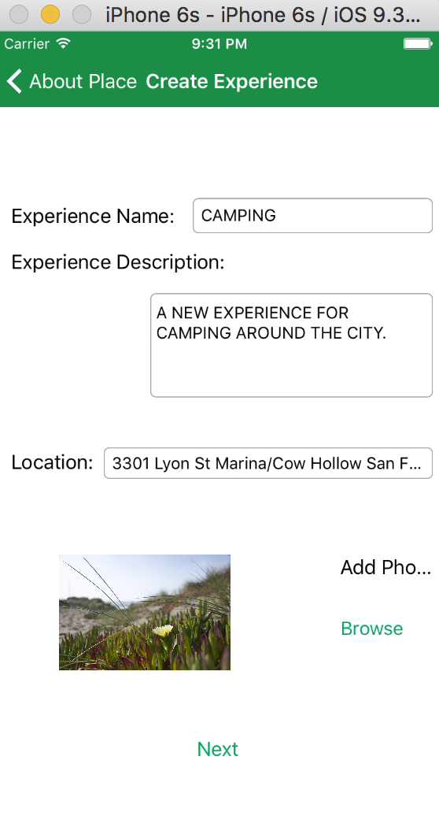
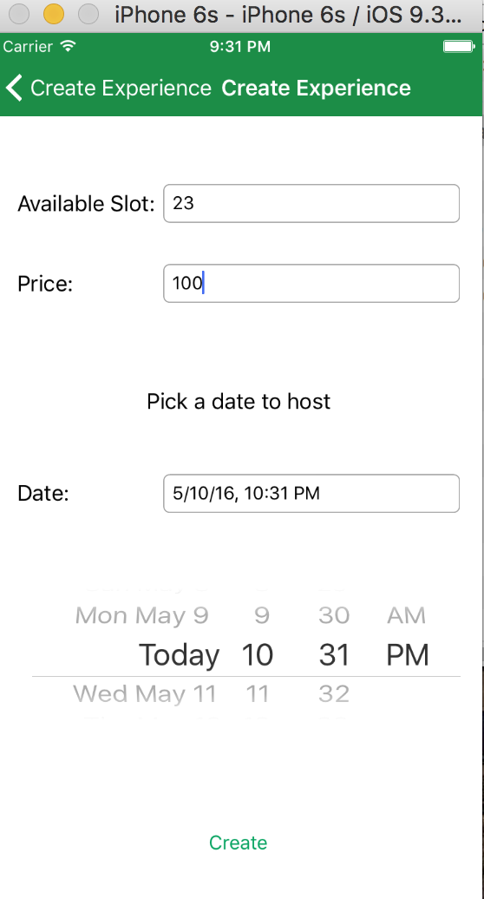
Create Experience
Use Camera and camera roll to add images
Use firebase database to store experiences

Slide 10
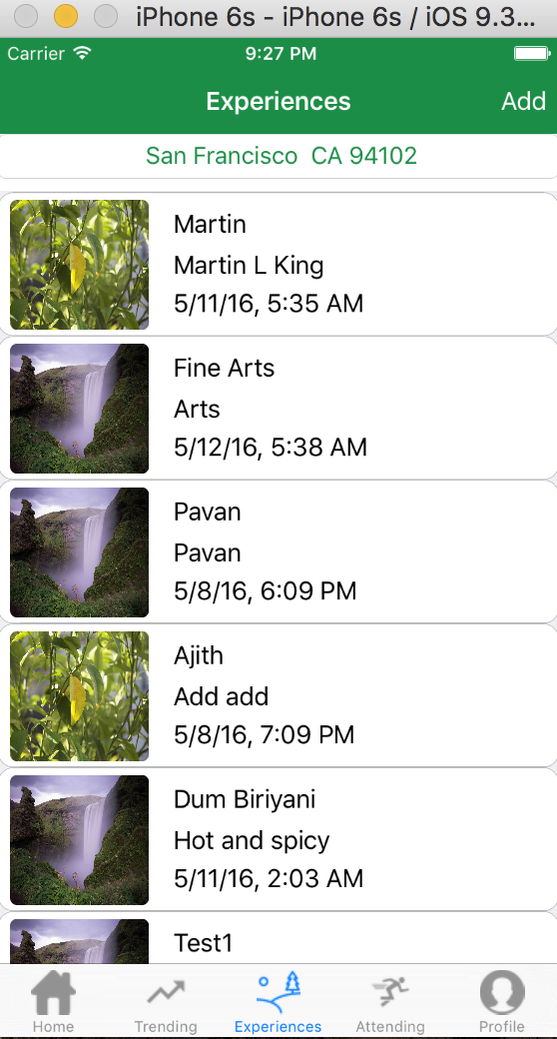
Experiences
Find the experiences hosted in that city

Slide 11
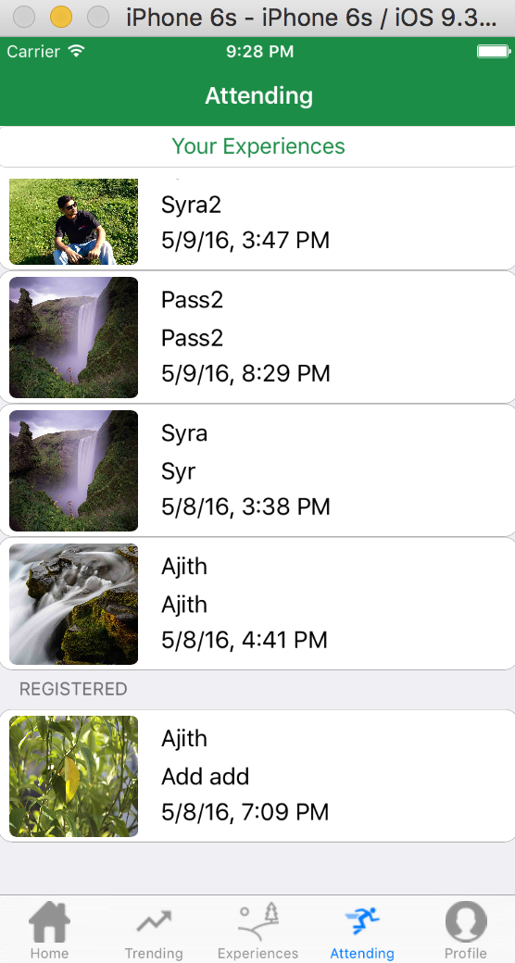
Attending Experiences
List of all the experiences you are attending

Slide 12
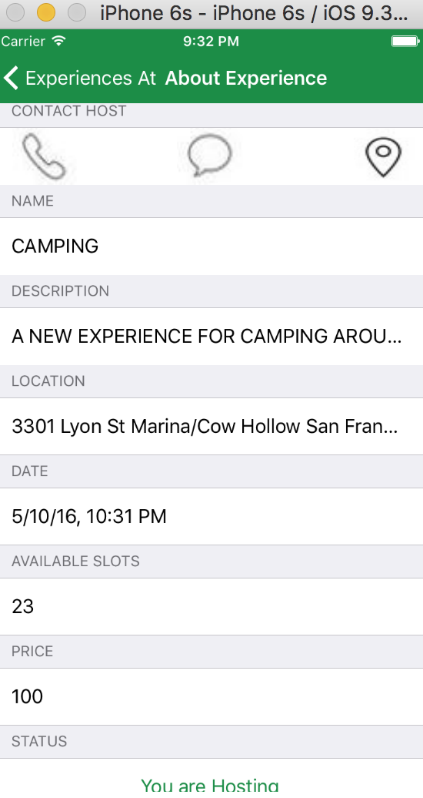
Details about that Experience
Call or text the hosted person
Get directions to that location on maps
Register/unregister for experience

Slide 13
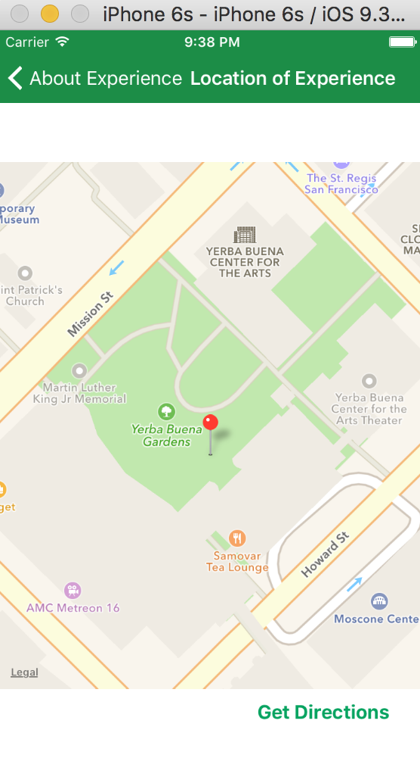
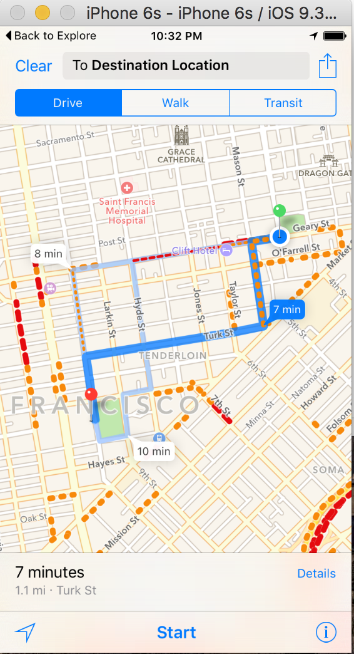
Location on map and directions
Location services and apple maps

Slide 14
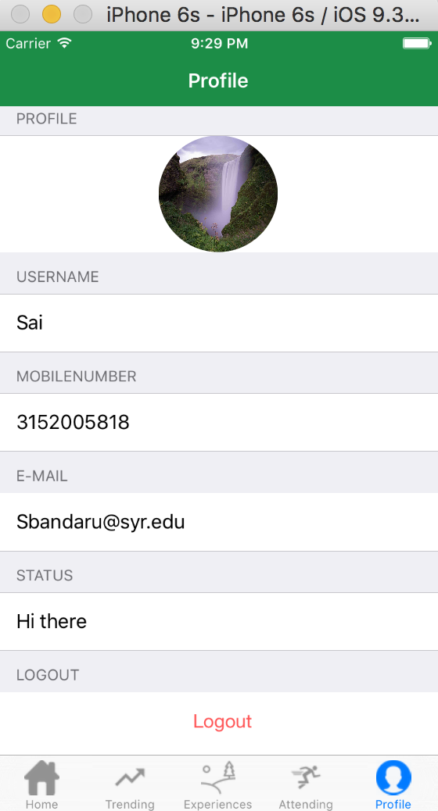
Profile
Edit user profile information including profile picture

Slide 15
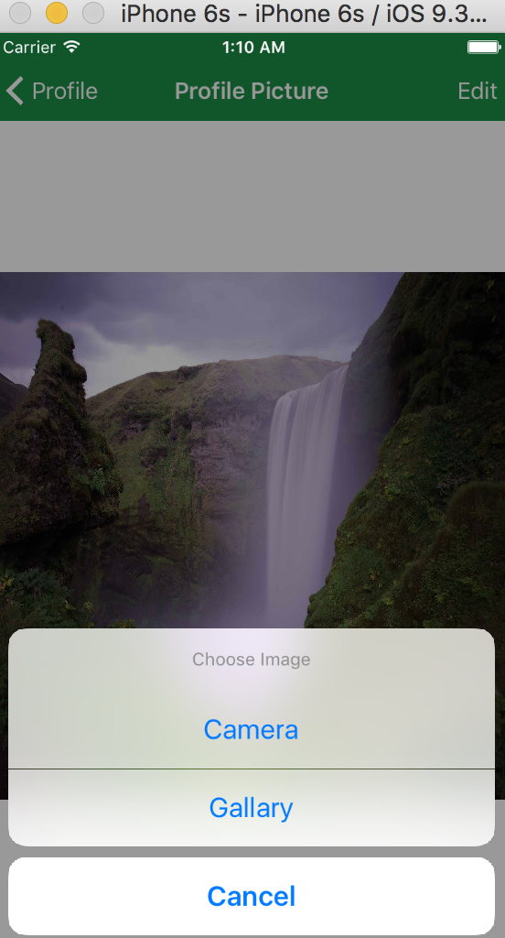
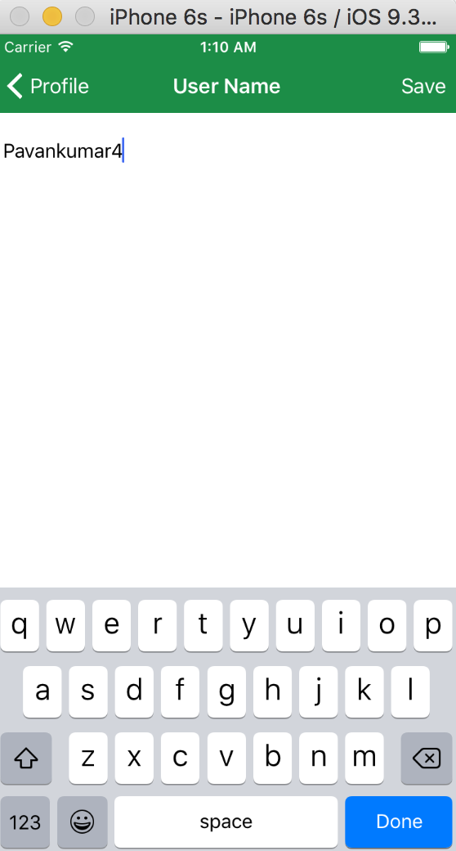
Edit Profile

Slide 16
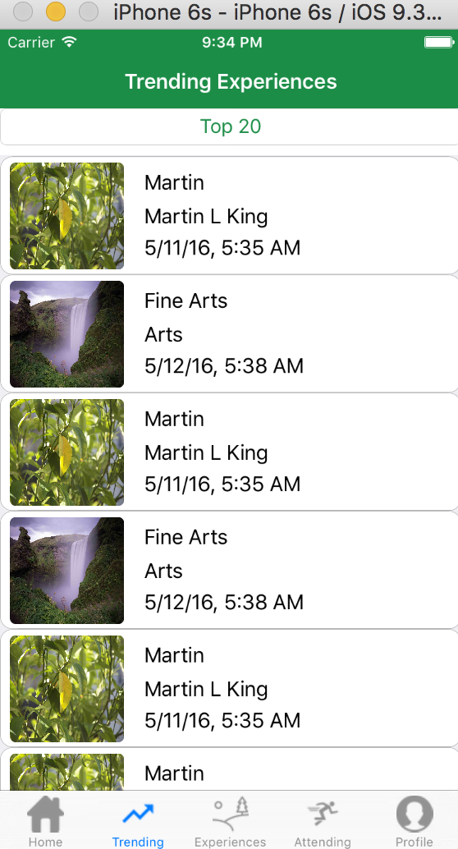
Trending Experiences
Show trending experiences

Slide 17
Further scope
Edit experience for host login
Payment options for that experience
Add reviews and ratings for experiences as well as hosts.
Add the hosts to your network if you like
Notifications to user if a host adds a new experience.

Slide 18
Any Questions?
Thank you for your time ☺

